Slide 1
CAP-841 INDUSTRIAL TRAINING
LOVELY PROFESSIONAL UNIVERSITY
PHAGWARA, PUNJAB
ATUL KUMAR
12102801

Slide 2
AGENDA
Company Profile
About Internship
​Course Syllabus
Domain: .NET Framework
Milestone Assessment
Certificate
​Summary​

Slide 3

COMPANY PROFILE
LTIMindtree Limited is an Indian multinational information technology services and consulting company based in Mumbai. A subsidiary of Larsen & Toubro, the company was incorporated in 1996 and employs more than 84,000 people. It is one of the top Big Tech companies.

Slide 4
About internship
(ignite)
Internship Duration : 9 to 12 weeks
Commencement Date : 21 Feb 2023 to 31 May 2023
Location : Remote
Domain Allotted: DOTNET

Slide 5
Course Syllabus
Topic Covered Under Internship
Foundation Programme
  Java
  OOPs
  SQL
  JavaScript Basic
Programming with C Sharp (C#)
  OOPs
  Syntax & Datatype
  Variables & Operators
Typescript & Angular
  Variables & Operators
  Components & Templates
  Directives & Routing

Slide 6
Introduction to dotnet framework

Slide 7
What is dotnet framework
.Net is a new framework for developing web-based and windows-based applications within the Microsoft environment.
The framework offers a fundamental shift in Microsoft strategy: it moves application development from client-centric to server-centric.

Slide 8
What is dotnet framework
.NET Application
.NET Framework
Operating System + Hardware

Slide 9
dotnet framework services
Common Language Runtime
Windows® Forms
ASP.NET
  Web Forms
  Web Services
ADO.NET, evolution of ADO
Visual Studio.NET

Slide 10
Framework, languages & tools
VB
VC++
VC#
JScript
…
Visual Studio.NET
Common Language Specification
ASP.NET: Web Services
and Web Forms
Windows
Forms
ADO.NET: Data and XML
Base Class Library
Common Language Runtime

Slide 11
Compilation in dotnet
Code in VB.NET
Code in C#
Code in another
.NET Language
VB.NET compiler
C# compiler
Appropriate
Compiler
IL(Intermediate
Language) code
CLR just-in-time
execution

Slide 12
Languages
Languages provided by MS
  VB, C++, C#, J#, JScript
Third-parties are building
  APL, COBOL, Pascal, Eiffel, Haskell, ML, Oberon, Perl, Python, Scheme, Smalltalk…

Slide 13
Milestone assessment (neocoder)
NeoCoder is the platform used to write tests in the IGNITE program. All tests like weekly and milestones were written on this platform.
The exam consists of 40% MCQ’s and 60% coding questions.
Exam Duration is 2hr 45 minutes.
45 minutes for MCQ’s
2 hours for Coding Questions
Passing criteria is 60%
I have cleared all the 3 MILESTONES with more than 60%.

Slide 14



Milestone score
Milestone 1
Milestone 2
Milestone 3
Test Score
72.00/80.00
Percentage
90%
Test Score
88.00/100.00
Percentage
88%
Test Score
87.00/100.00
Percentage
87%

Slide 15
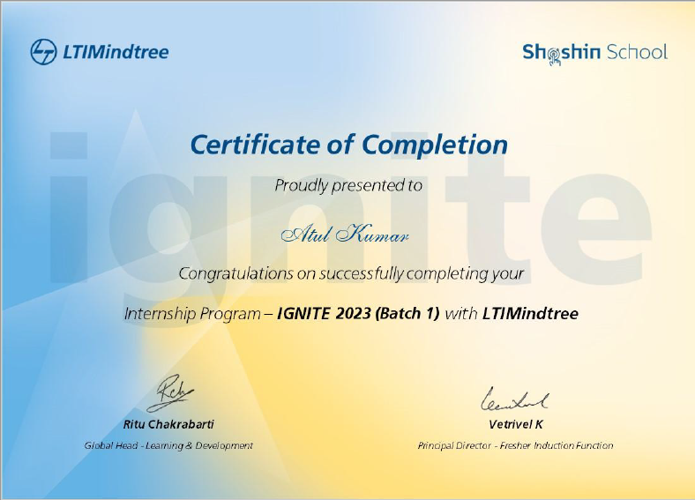
Certificate

Slide 16
SUMMARY
The Internship period in LTIMindtree has been very productive and helpful. There is a big difference in the academic course and the tasks and activities during the actual work. In college we learn how quality is important and some basic quality software benefits and features, where during internship, it is learnt far more than the basics.

Slide 17
THANK YOU

